Slide 1

Cross Platform Application Development
Food Delivery Application
Rahul Siddarth B, Sonal Jain, Nagabhushan Hande R
PRESENTED BY:
09
TEAM NO:
2YB
BATCH:

Slide 2

Agenda
About Project
Architecture/ Design
Application Screen Snippets
Challenges

Slide 3
About Project
Creating a food delivery app with React Native and Sanity.io combines the efficiency of a cross-platform mobile development framework with the flexibility of a content management system.
React Native allows for the seamless development of both iOS and Android applications, ensuring a consistent user experience across devices.
Leveraging Sanity.io as the backend provides a robust and customisable content management system, allowing developers to easily manage and update menu items, prices, and other essential information.
We have a login screen, followed by catalogue of restaurants with their menus.
Users can place an order after which a post call is made to store order details in the dashboard.

Slide 4
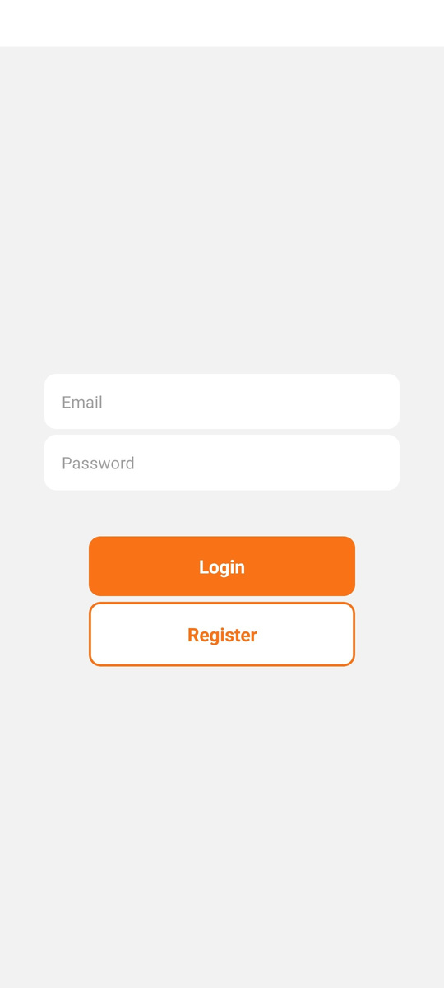
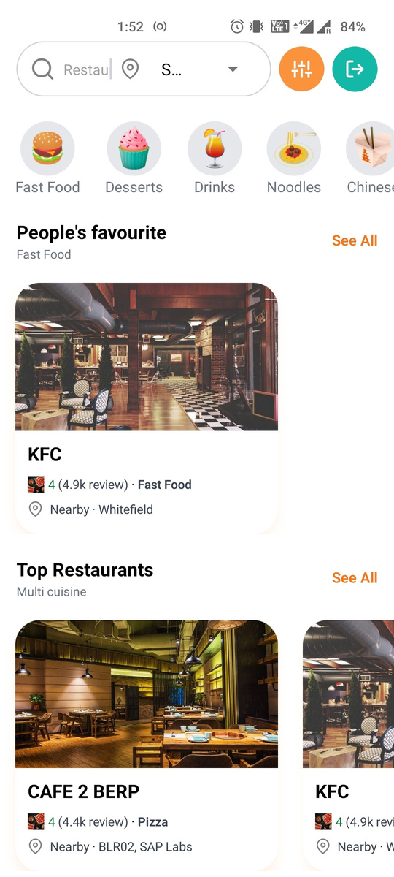
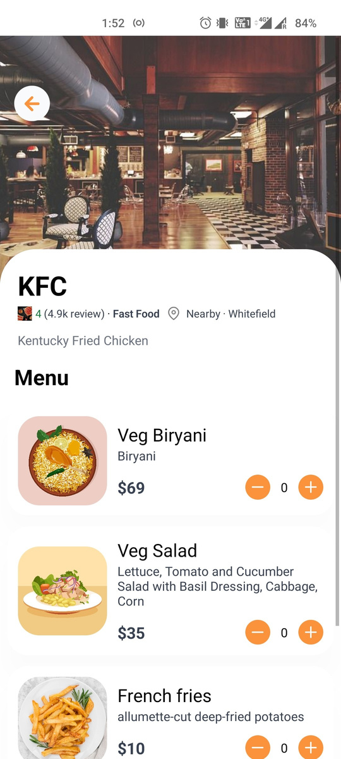

Slide 5
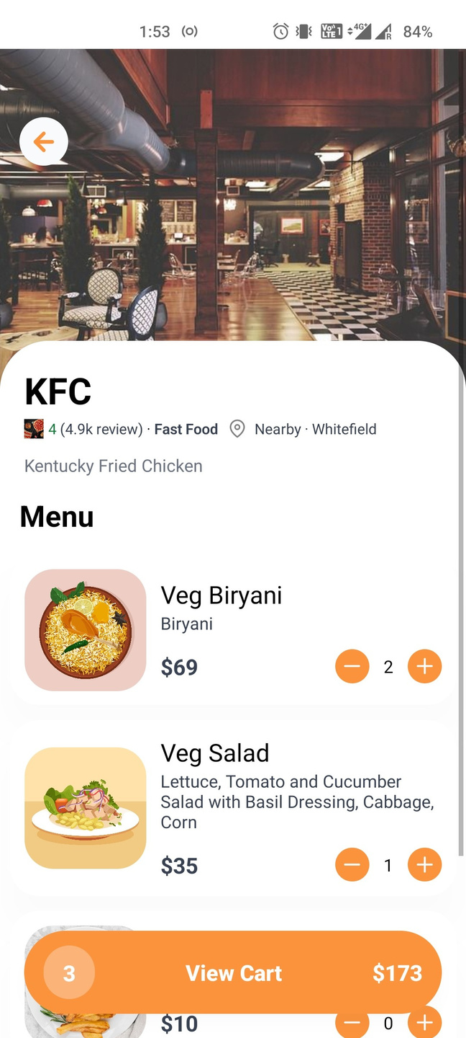
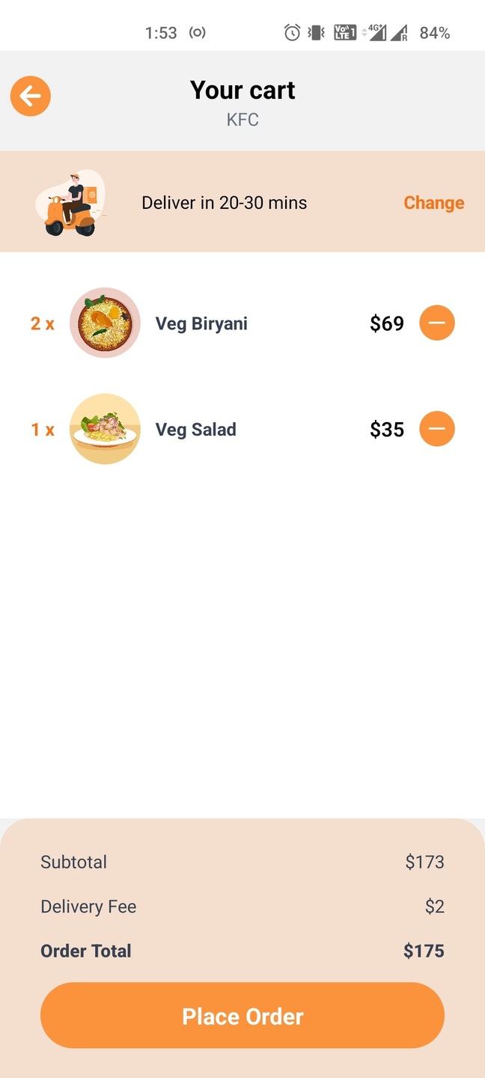
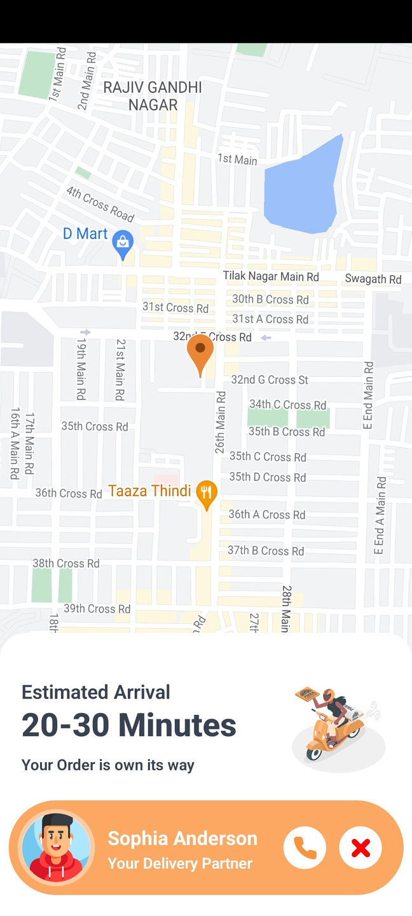

Slide 6
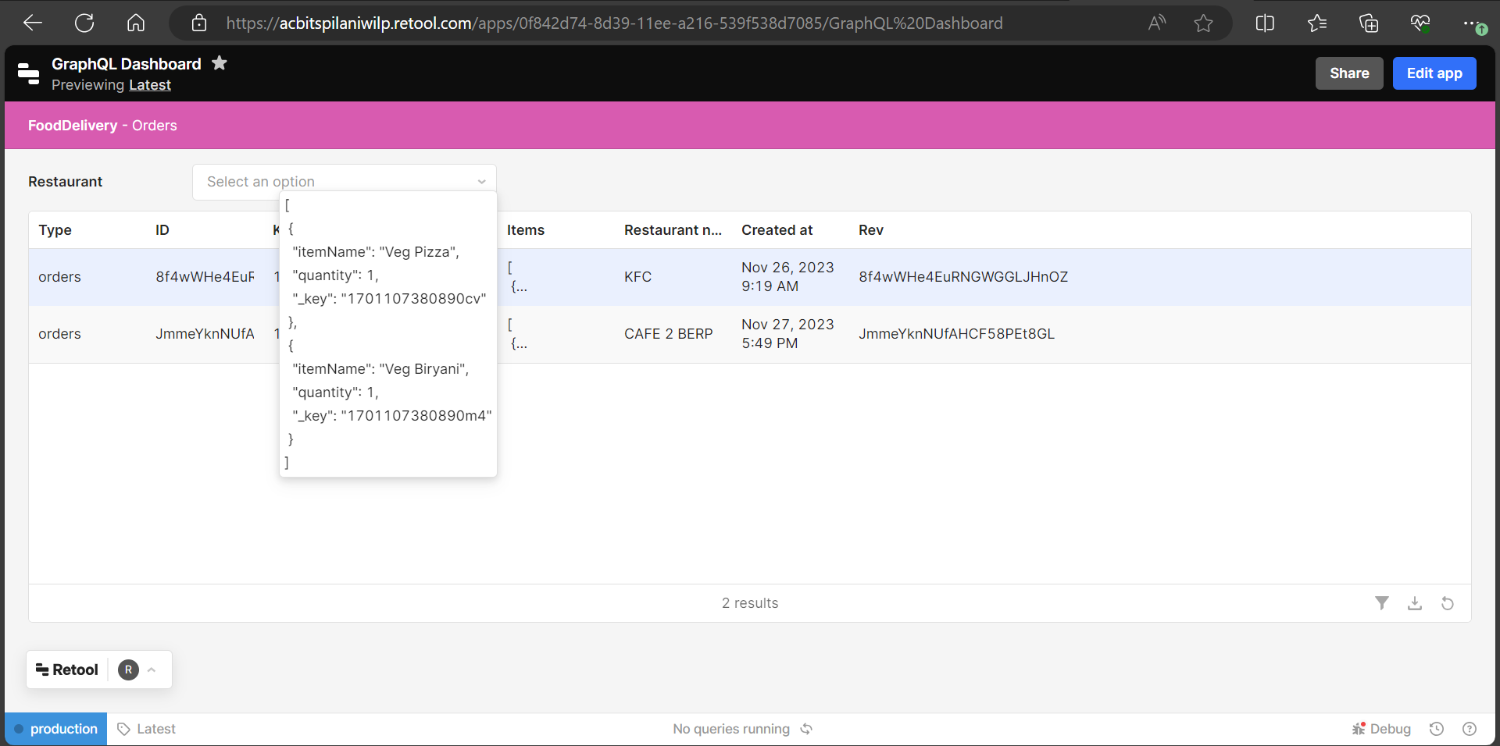

Slide 7






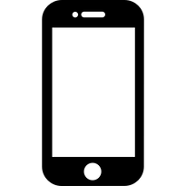


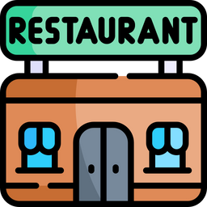
APPLICATION DESIGN
Authentication
Orders Dashboard
API gateway
Customer
Sanity.io
CDN

Slide 8
Challenges
Implementing Map view
Storing location data in the database and querying the nearest coordinates from the data layer was challenging. The database should support location based datatype to store the coordinates and should also provide inbuilt functions to find the closest coordinates for the given location points.
Storing of Static Assets
Our application includes many images and animations which has a big file size and loading these files on the client takes lot of time. Using CDN which helps these assets place it close to the client thus making the client download it quickly.

